Slide 1
Applications of NoSQL Architecture and Graphs in Unstructured Data Warehouse for Testing and Visualization
By Edward Rao

Slide 2
Introduction
Sequel aka SQL; versatile, is the most popular DB language, fundamentally the basis of working with data modification in RDBs
NoSQL, aka Not ONLY SQL, is an alternative that both stores and represents data in different ways, aka document, graph, pairs, etc; it’s generally considered more flexible than SQL in terms of versatility
Other points of contention include scaling, querying, and model schematics
Not quite conversion, but more like representing SQL data in a NoSQL manner

Slide 3
Problem Statement
Lack of emphasis on independent unstructured data and how it can be incorporated into and represented by alternative technology, such as NoSQL
Establishing unstructured data and its ever-expanding role and applying graphs in a sensible way to existing data warehouse structures
SQL and NoSQL are not the same; their functionality differs and can’t be directly translated
What can be carried over, and what lies outside the scope?
How can we add functionality to a program that does not intrinsically include these functions?
How many of these can we realistically include?
Would a direct conversion be easier?

Slide 4
SQL and NoSQL
While similar in terms of origin, SQL and NoSQL have stark differences that could make a direct copy->paste difficult
Despite this, certain command “equivalences” are already present between both types of programs
Graphs could be an oversimplified view and miss capturing the essence of data warehousing in terms of aggregation and user OLAP
However, it also supports user-friendliness, simplicity, streamlined, and could be a good alternative to visualization

Slide 5
“Prototype” Case Study
Not a new individual program, but instead will be using available NoSQL platforms in MongoDB for the reviews data
In this case, we can load a csv and assign each column entry to a specified node via Cypher statements
Node labels are the dimensional attributes ie customer address for customer
Instructions for both can be found in the paper

Slide 6
MongoDB
A NoSQL database platform that operates using JSON-like files and schemas
Many similarities to MySQL and Neo4j, leading to easier translatability and modification
Uses key-value pairs to store individual documents (records)
Harder to operate on local system, so using a service like MongoDB Atlas or MongoDB Compass helps

Slide 7
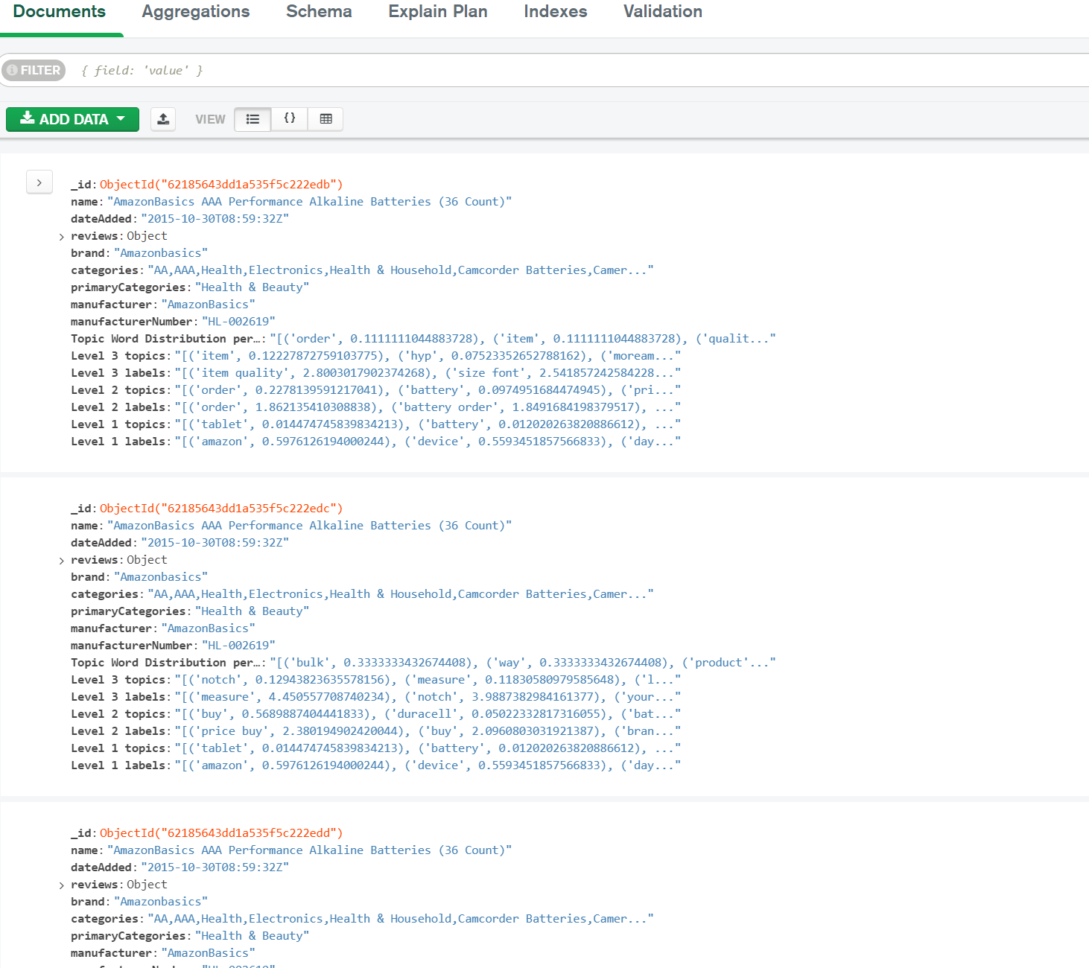
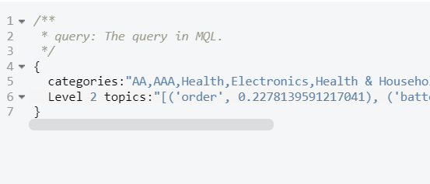
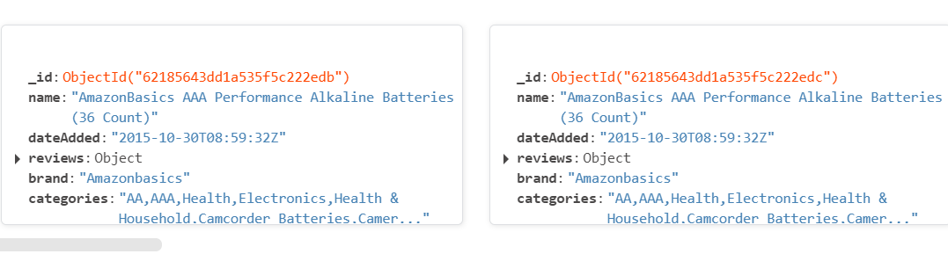

Slide 8
Neo4J
Compared to Mongo, not as versatile in querying and data manipulation
Very geared towards different purposes, as Neo4j emphasis only on graphs and visualizing it as such
Unlike Mongo, has no real “transfer” or migration system w/o complications, importing CSV only
Relationships are assigned and manual, particularly between document rows

Slide 9
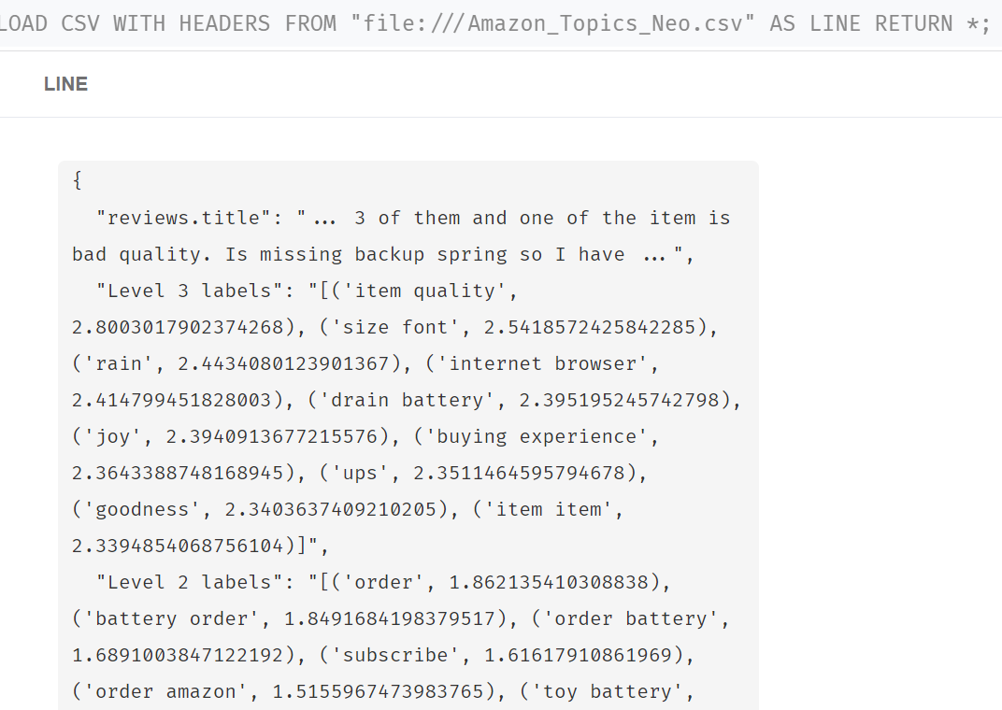
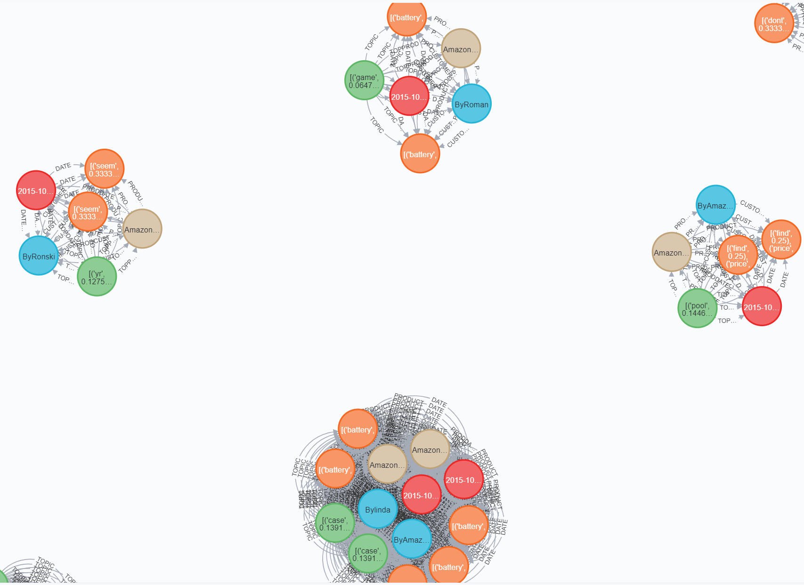

Slide 10
Future Direction
Explore size and performance concerns
Storage and visualization are key, but understanding and capturing the data for users’ queries is even more important
Integration could be challenging, but compatibility and inclusion of key functions across both programs is something that will definitely be achievable
Reference possible visuals and how graph technology can be used, particularly outside of NoSQL using more standard SQL functionality

